Slide 1

Object-Oriented Software Analysis & Design (COMP-3220) Lecture 6 Command Pattern
School of Computer Science
Faculty of Science
University of Windsor
Dr. Saeed Samet

Slide 2
Intent
The Command Pattern encapsulates a request as an object, allowing you to:
Parameterize clients with requests
Queue requests
Log requests
Support undo/redo operations
In simple terms:
Turn a request into an object.
Instead of calling a method directly, the client creates a command object and asks it to execute.

Slide 3
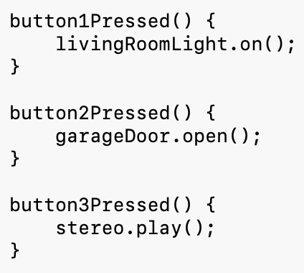
Motivation
Suppose you are building a smart-home remote control. Without the Command Pattern:
Problems:
Remote control is tightly coupled to devices.
Adding new devices requires modifying the remote.
Undo functionality is difficult.
Commands cannot be stored or queued.
We want the remote to know only:
command.execute();
without caring what the command actually does.

Slide 4
Problems It Solves
Decouples Sender and Receiver
The object requesting an action does not need to know who performs it.
Simplifies Extensibility
New commands can be added without modifying existing code.
Supports Undo/Redo
Commands can remember previous state and reverse actions.
Supports Queuing
Commands can be stored and executed later.
Supports Logging
Commands can be recorded and replayed.

Slide 5
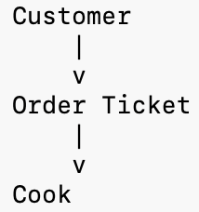
Real-Life Analogy
Restaurant Order Slip
Imagine a restaurant:
Customer
Places an order: Cheeseburger
Waiter
Writes the order on a ticket
Cook
Prepares the meal
The customer does not directly communicate with the cook.
The order slip acts as the Command.
The ticket encapsulates the request.

Slide 6
Real-Life Analogy
TV Remote Control
When you press:
Power
the remote does not know how the TV works internally.
It simply sends a command:
TurnOnCommand
The TV executes the action.

Slide 7
Command Pattern Structure
Main Participants
Command
Declares: execute()
ConcreteCommand
Implements the command.
Stores a receiver.
Receiver
Performs the actual work.
Invoker
Triggers commands.
Client
Creates and connects everything.

Slide 8
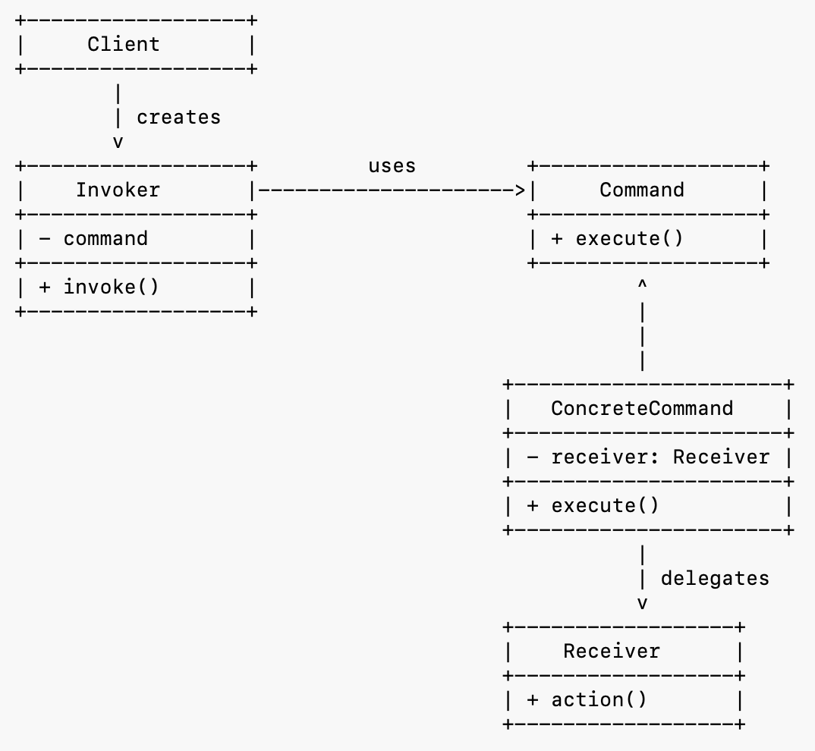
Command Pattern – Class Diagram

Slide 9
How the objects collaborate
Client
Creates a Receiver.
Creates a ConcreteCommand, passing the receiver to it.
Creates an Invoker.
Assigns the command to the invoker.
Invoker
Stores a reference to a Command.
Calls execute() when a request occurs.
ConcreteCommand
Implements execute().
Delegates the actual work to the receiver.
Receiver
Knows how to perform the requested operation.

Slide 10
Example: Smart Home Remote
We want a remote control that can control:
Lights
Garage Doors
Fans
without changing the remote’s code.

Slide 11
How It Works
Step 1
Client creates receiver: Light light = new Light();
Step 2
Client creates command: Command cmd = new LightOnCommand(light);
Step 3
Client creates invoker: RemoteControl remote = new RemoteControl();
Step 3
Command is assigned to invoker: remote.setCommand(cmd);
Step 4
User presses button: remote.pressButton();
Step 5
Remote executes: command.execute();
Step 6
Command calls receiver: light.on();

Slide 12
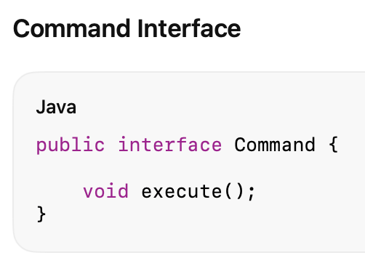
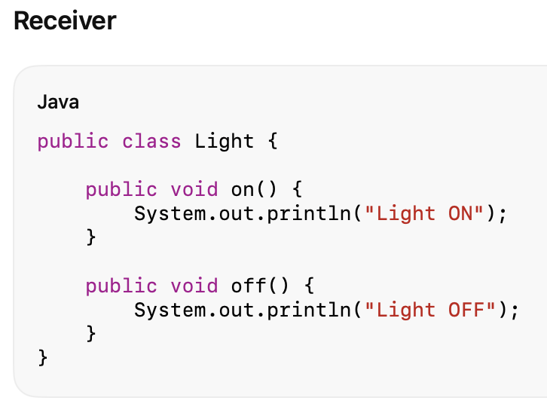
Java Code

Slide 13
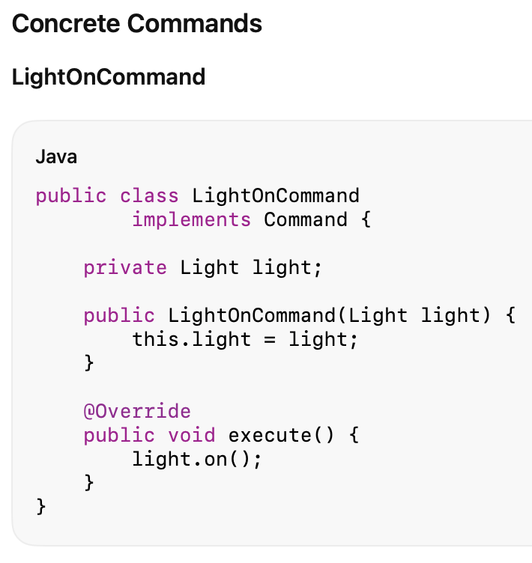
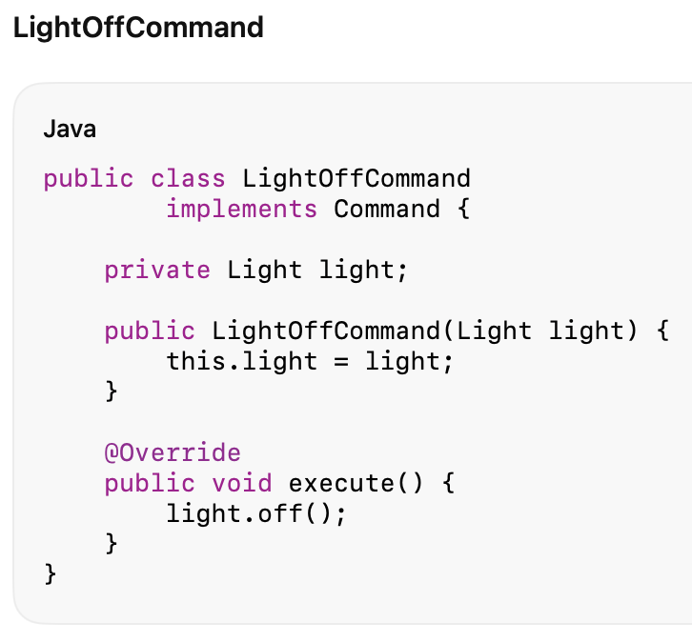
Java Code

Slide 14
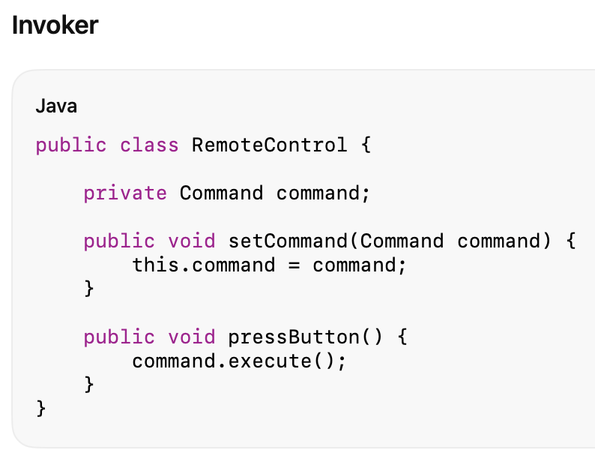
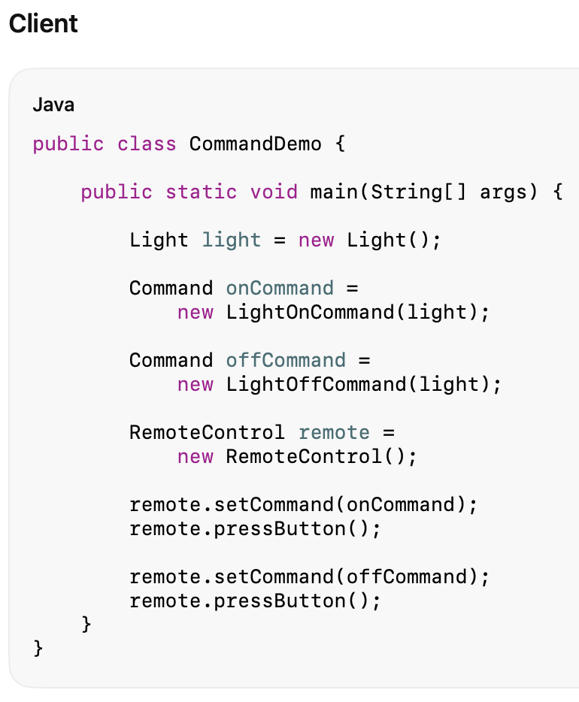
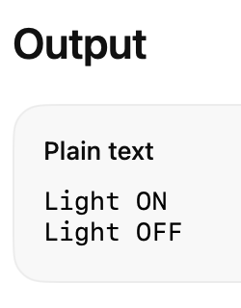
Java Code

Slide 15
Undo Example (Simplified)
We want a remote control that can control:
Lights
Garage Doors
Fans
Without changing the remote’s code
With undo capability.

Slide 16
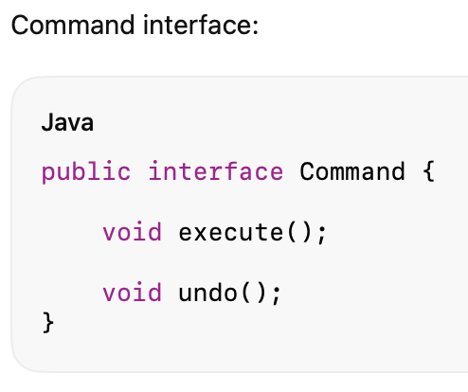
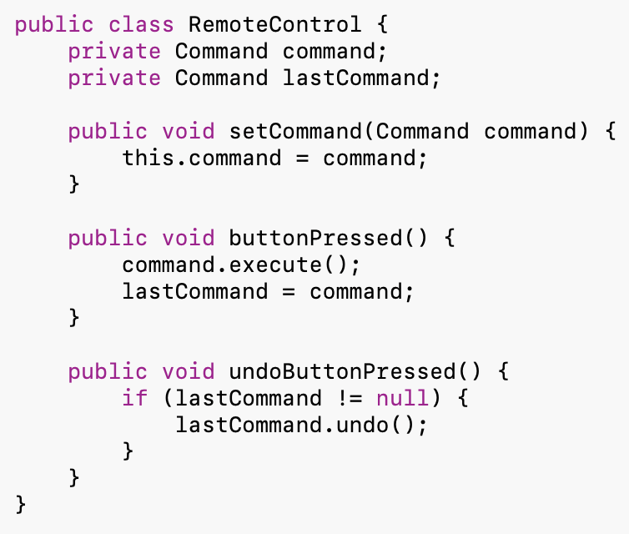
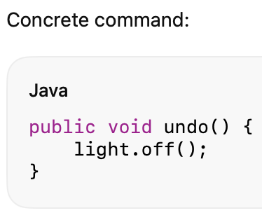

Java Code
Invoker:
Client:

Slide 17
Challenge
How about pressing undo button multiple times?
Keep the history of the actions executed.
How? Which class must be modified?

Slide 18
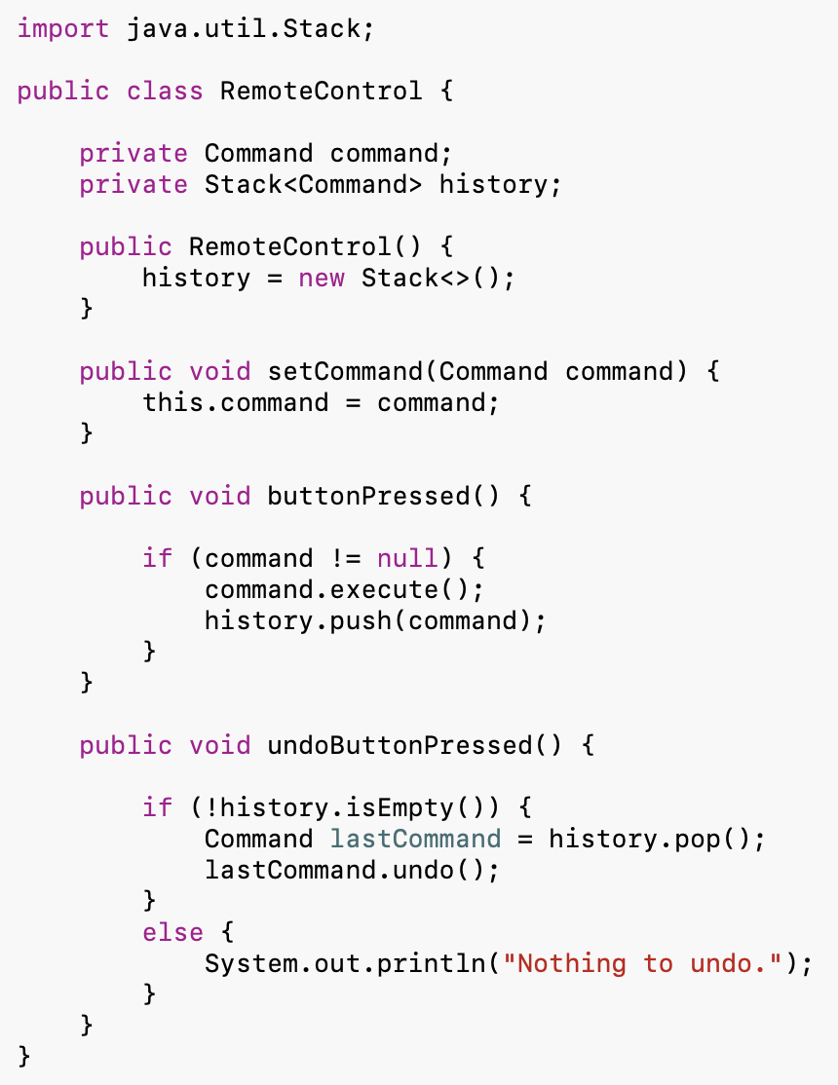
Invoker Class with History

Slide 19
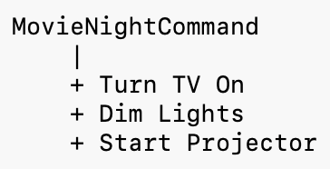
Advantages
Decouples Sender and Receiver
Invoker does not know implementation details.
Supports Open-Closed Principle
New commands can be added without changing existing code.
Supports Undo/Redo
Commands can reverse previous actions.
Supports Queuing
Commands can be stored and executed later.
Supports Logging
Commands can be saved and replayed.
Simplifies Macro Commands
A command can execute multiple commands.
Example:

Slide 20
Disadvantages
More Classes
Each action often requires its own command class.
Increased Complexity
Simple systems may become over-engineered.
Additional Indirection
Instead of:
light.on();
you now have:
command.execute();
which adds an extra layer.

Slide 21
When to Use Command Pattern
You want to decouple sender and receiver
You need undo/redo functionality
Examples:
Text editors
Drawing applications
You need command queues
Examples:
Job schedulers
Task management systems
You need operation logging
Examples:
Transaction systems
Audit systems
You need macro-operations
Examples:
Home automation
IDE build commands

Slide 22
Real-World Examples
Remote Controls
PowerCommand
VolumeUpCommand
ChannelDownCommand
Text Editors
CopyCommand
PasteCommand
DeleteCommand
UndoCommand
Home Automation
OpenGarageCommand
TurnLightOnCommand
LockDoorCommand

Slide 23
Key Insight
The Command Pattern says:
“Encapsulate a request as an object so that the requester and the performer of the action are independent.”
The invoker only knows:
command.execute();
It does not know:
light.on();
garage.open();
fan.start();
This separation makes the system more flexible and extensible.

Slide 24
Summary
Aspect | Command Pattern
Category | Behavioral
Purpose | Encapsulate requests as objects
Main Participants | Command, ConcreteCommand, Receiver, Invoker, Client
Main Benefit | Decouples sender from receiver
Supports Undo/Redo | Yes
Supports Queuing | Yes
Supports Logging | Yes
Typical Example | Remote Control
Main Drawback | Large number of command classes

